Slide 1
GE Predix
Microservices & API
Status Reporting
June 9, 2016

Slide 2
Scope/Goal
Milestones
Where we are now
Challenges & Risks

Slide 3
Solution Context
Opportunities
Today, functionality in InSight is delivered to GE’s customers primarily through GE-developed applications such as InSight Web and InSight mobile applications.
Substantial opportunities exist for GE to create and market secure, reliable, standards-based Application Programming Interfaces (APIs) for InSight that will
Enable GE to:
Generate new revenue streams from GE’s existing investments in InSight
Market individual capabilities and packages of capabilities in InSight as subscriptions
Gain deep visibility in demand and usage of individual features and functionality in InSight through usage metering
Accurately invoice customers, users, and developers based on their actual usage of InSight features and functionality
Enable GE’s customers, InSight users, and application developers to:
Integrate securely with InSight though standards-based Web interfaces
Incorporate GE InSight functionality into applications and IT solutions
Create new and innovative solutions & applications built on capabilities and functionality available in Insight
Automate human interactions with InSight to reduce costs and exposure to operational risks
Automate reactions to events, trends and alarms in InSight in order to shorten reaction times and prevent service disruption & outages
Additional opportunities are seen for enhancements to reporting in InSight:
Ability to deliver reports to external systems through standard integration mechanisms (ex: HTTP/S POST)
Ability to report on data from multiple data sources

Slide 4
Solution Context
Goals/Objectives
Modernize functionality in InSight by transforming existing functionality to cloud-native, hyper-scalable microservices
Create a secure, scalable API layer which provides GE’s customers, InSight users, and developers standards-compliant programmatic access to InSight capabilities and functionality through RESTful APIs
Initial focus area for APIs: Reporting
Enhance InSight reporting to support the following additional use cases:
Multiple data sources (through data federation within Predix Environment)
Delivery of reports to external systems through standards-compliant Web-based integrations: event notifications/web hooks, HTTPS posts, etc.
Anticipated Outcomes
100% of GE InSight’s reporting capabilities available through secure REST based APIs
Reporting functionality is elastically scalable, leveraging cloud based infrastructure to automatically scale up and down as required, increasing infrastructure efficiency and reducing exposure to operational risks such as performance problems, scaling challenges, and service unavailability
Functionality improvements around reporting are in place:
Reports are able to leverage data from multiple data sources within Predix
Reports are able to be delivered to external systems through standard Web based delivery mechanisms
Continuous Integration and Delivery practices for version control, inspection automation, build automation, test automation, and deployment automation are in place and operational for reporting and for all new services created, minimizing time and manual effort required to deliver new functionality.

Slide 5
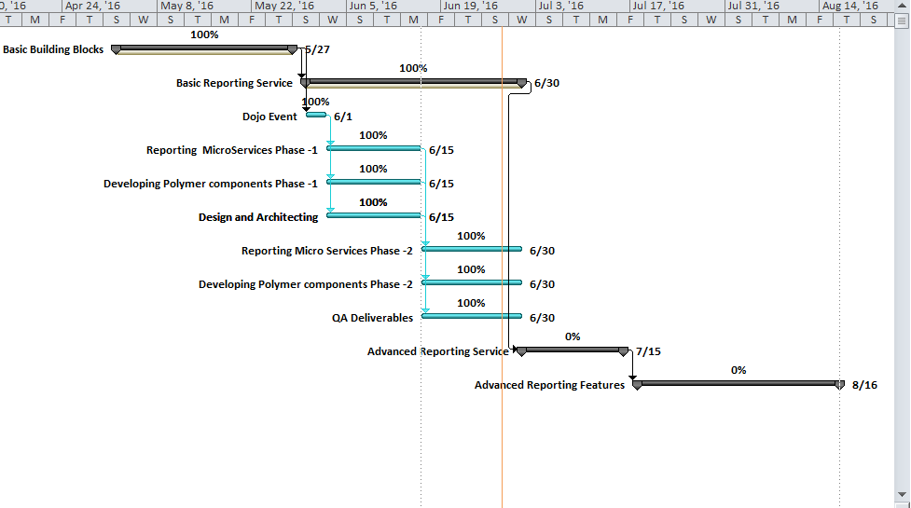
Overall Project Mile Stone

Slide 6
Predix & InSight
Components in Use
Evaluation
UI
Bower
Polymer
Data Systems
Predix Time Series
Predix Asset
Grunt
Node
Predix PostgreSQL
Angular2
Billing/Metering
ReportsLab
API Framework
Java Spring Boot
Python
APM
Predix UAA/ACS
Cloud Foundry
Other Services
ReportsLab
Sample App
Asset Model SetUp
Times Series SetUp
Job Scheduler
Implementation in Prostgres SQL

Slide 7
Milestone
Completed
Planned
Goals
Line Chart
Bar Chart
Blue prints List
Report List
Canvas
Reporting UI
Pie chart
Vertical Bar chart
Basic Data Table
Report Generation
Report Management
Goals
Advanced Chart Features
CP chart, Image Services, Base text Editor
Loading Blue prints
Maintain Report History
Preview PDF
Scheduler Functionality
Data Abstraction Layer
Raw Data Report
Reports Generation Queuing System
Repots Generation Workers, Reports Emailer
Administration UI ,Configure TS/AM

